Slide 1

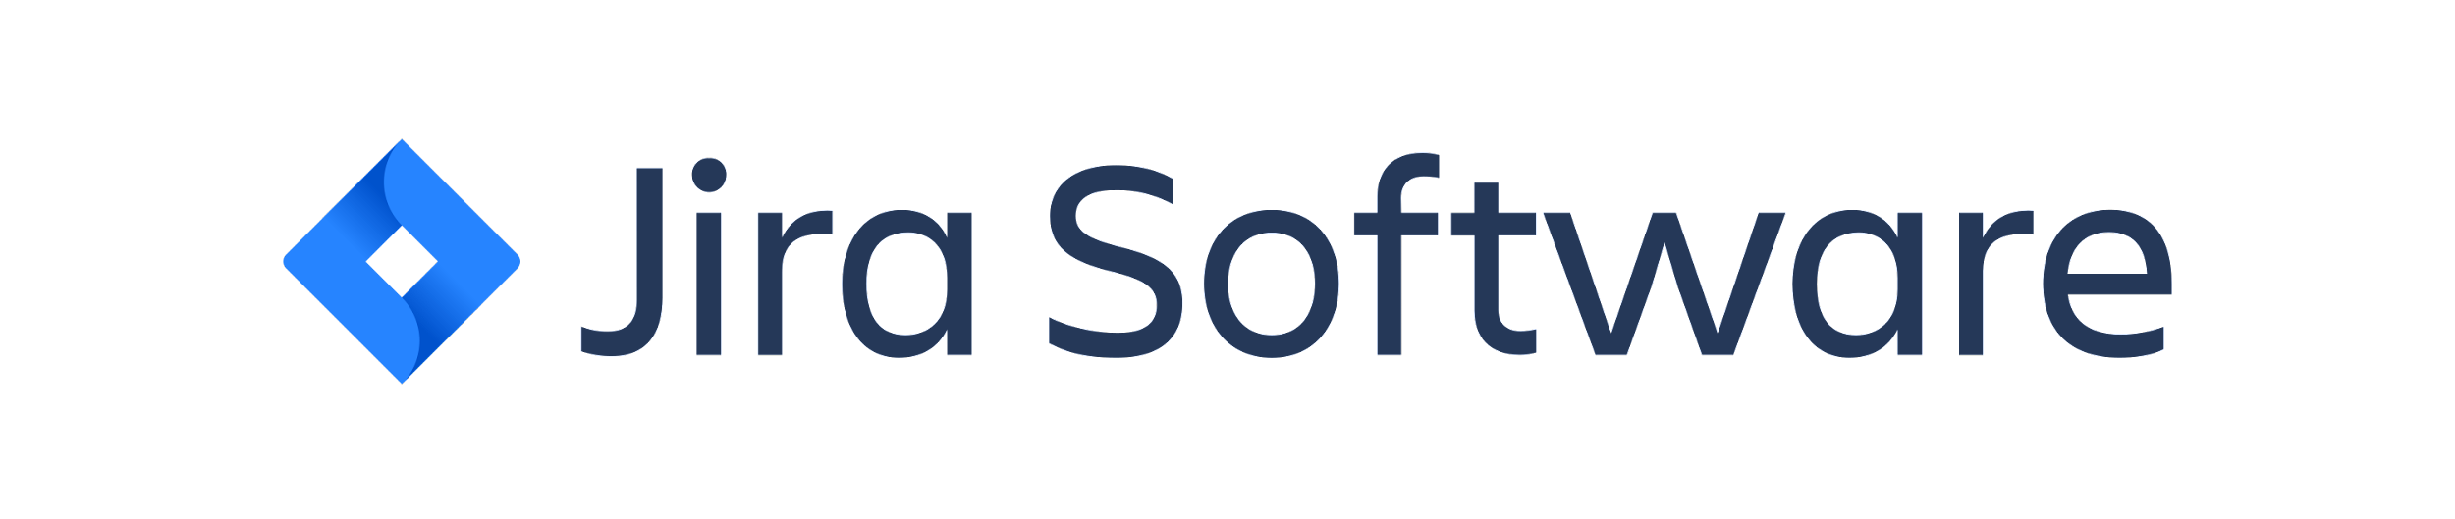


Complete JIRA Tutorial
Pramod Dutta Lead SDET.
How Companies Use JIRA for Project Development?

Slide 2
Agenda
Understand JIRA
Work on Scrum / Sprints
EPIC / STORY / TASK with LIVE Project
Test case management with Zephyr
Reporting and Test Estimation
Scrum Framework
JIRA Interview Questions ans Anwsers.

Slide 3

What is JIRA?
JIRA is an issue Tracking Product.
Developed by Atlassian.
Jira was designed as a bug and issue tracker.
Allow to bug tracking and Agile Project management.
Jira has evolved into a powerful work management tool for all kinds of use cases, from requirements and test case management to agile software development.

Slide 4
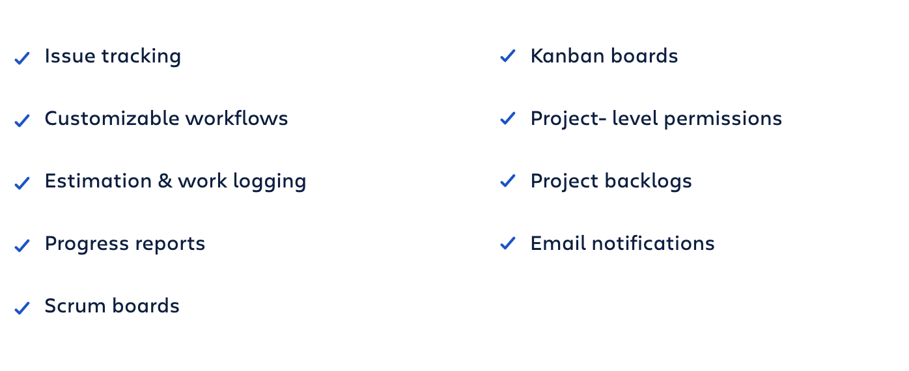
Why JIRA is Used?

Slide 5
Jira for project management teams

Slide 6
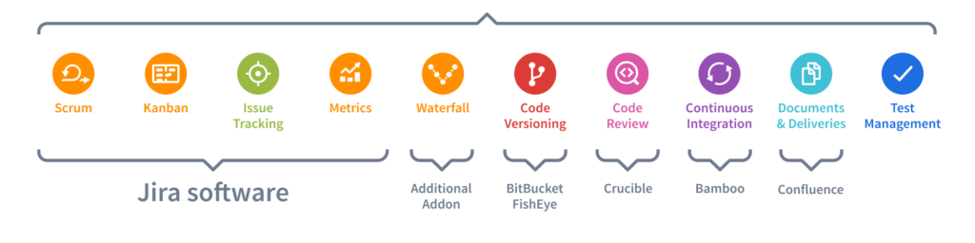

Slide 7
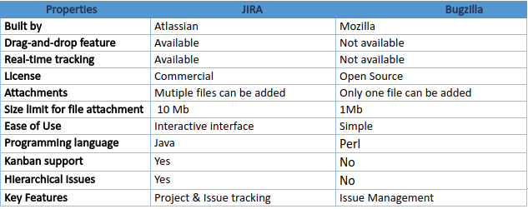
JIRA Vs Bugzilla

Slide 8
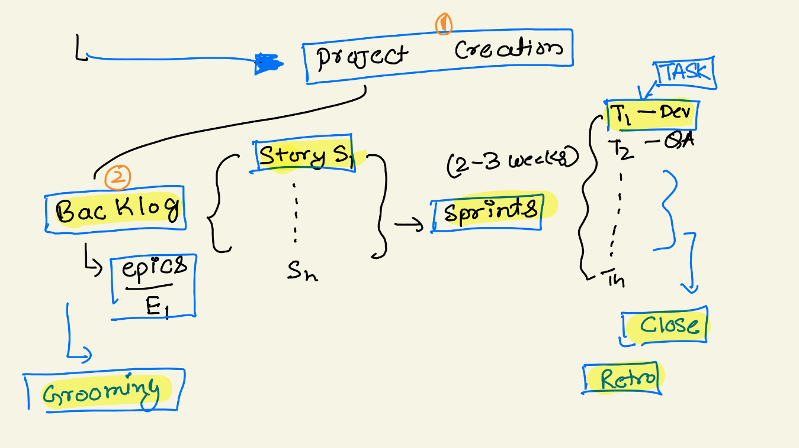

Slide 9
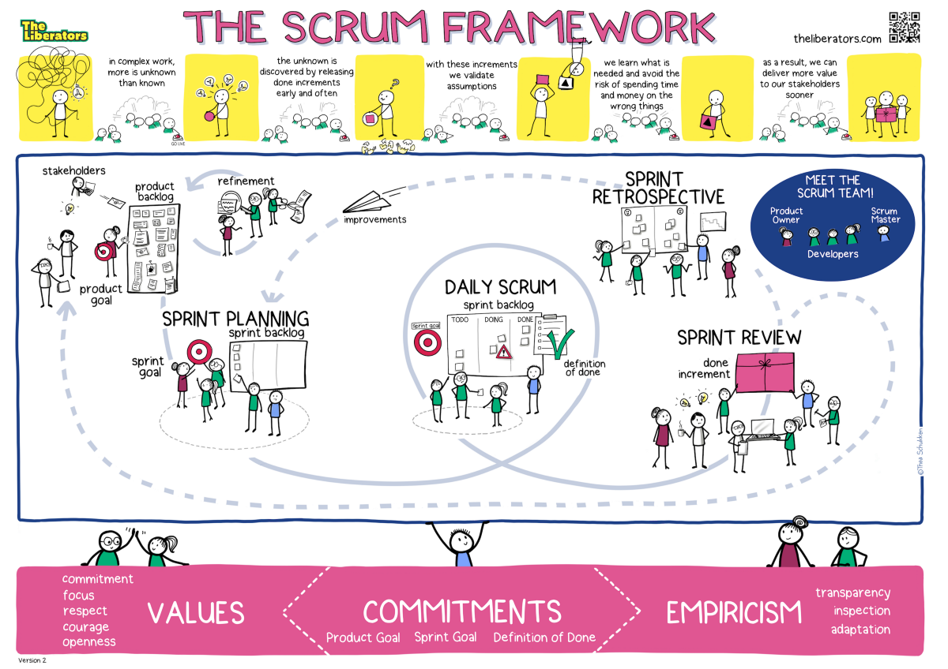

Slide 10
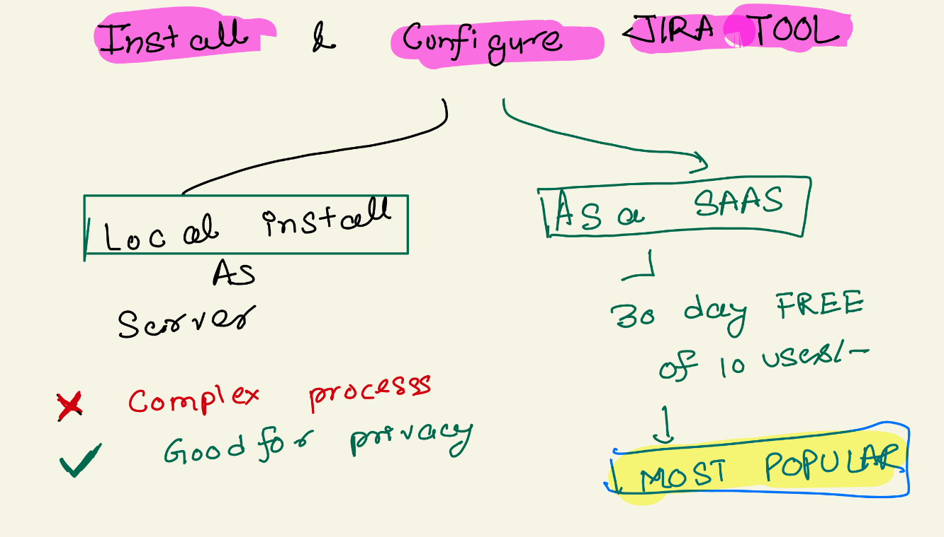

Slide 11
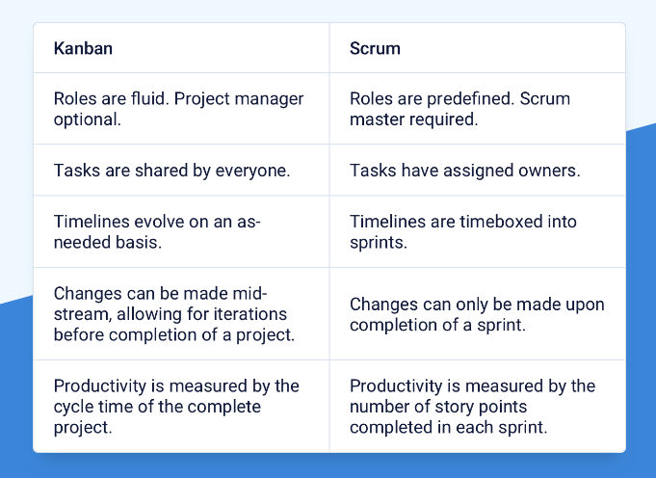

Slide 12
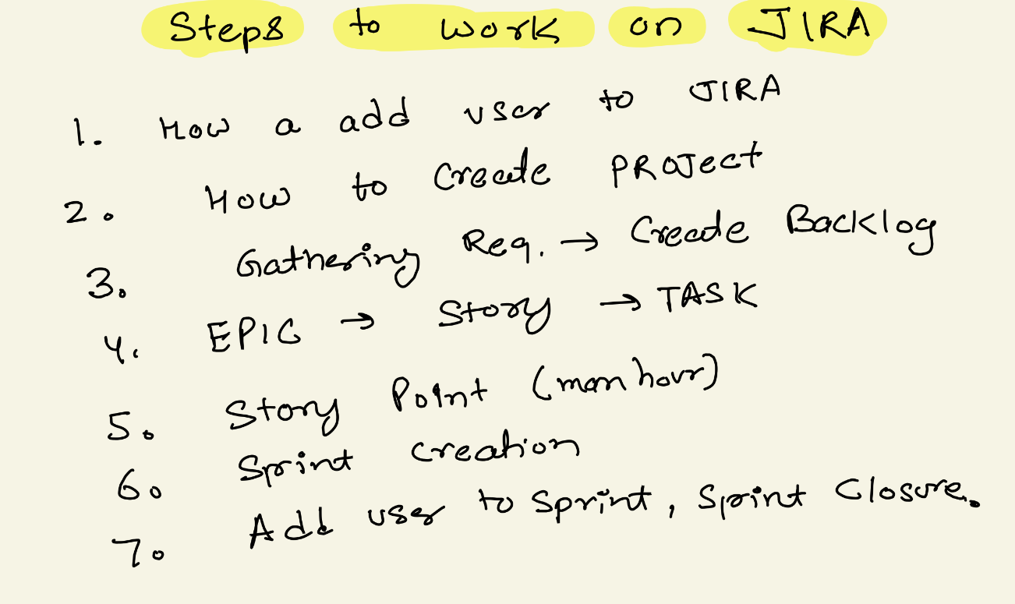

Slide 13
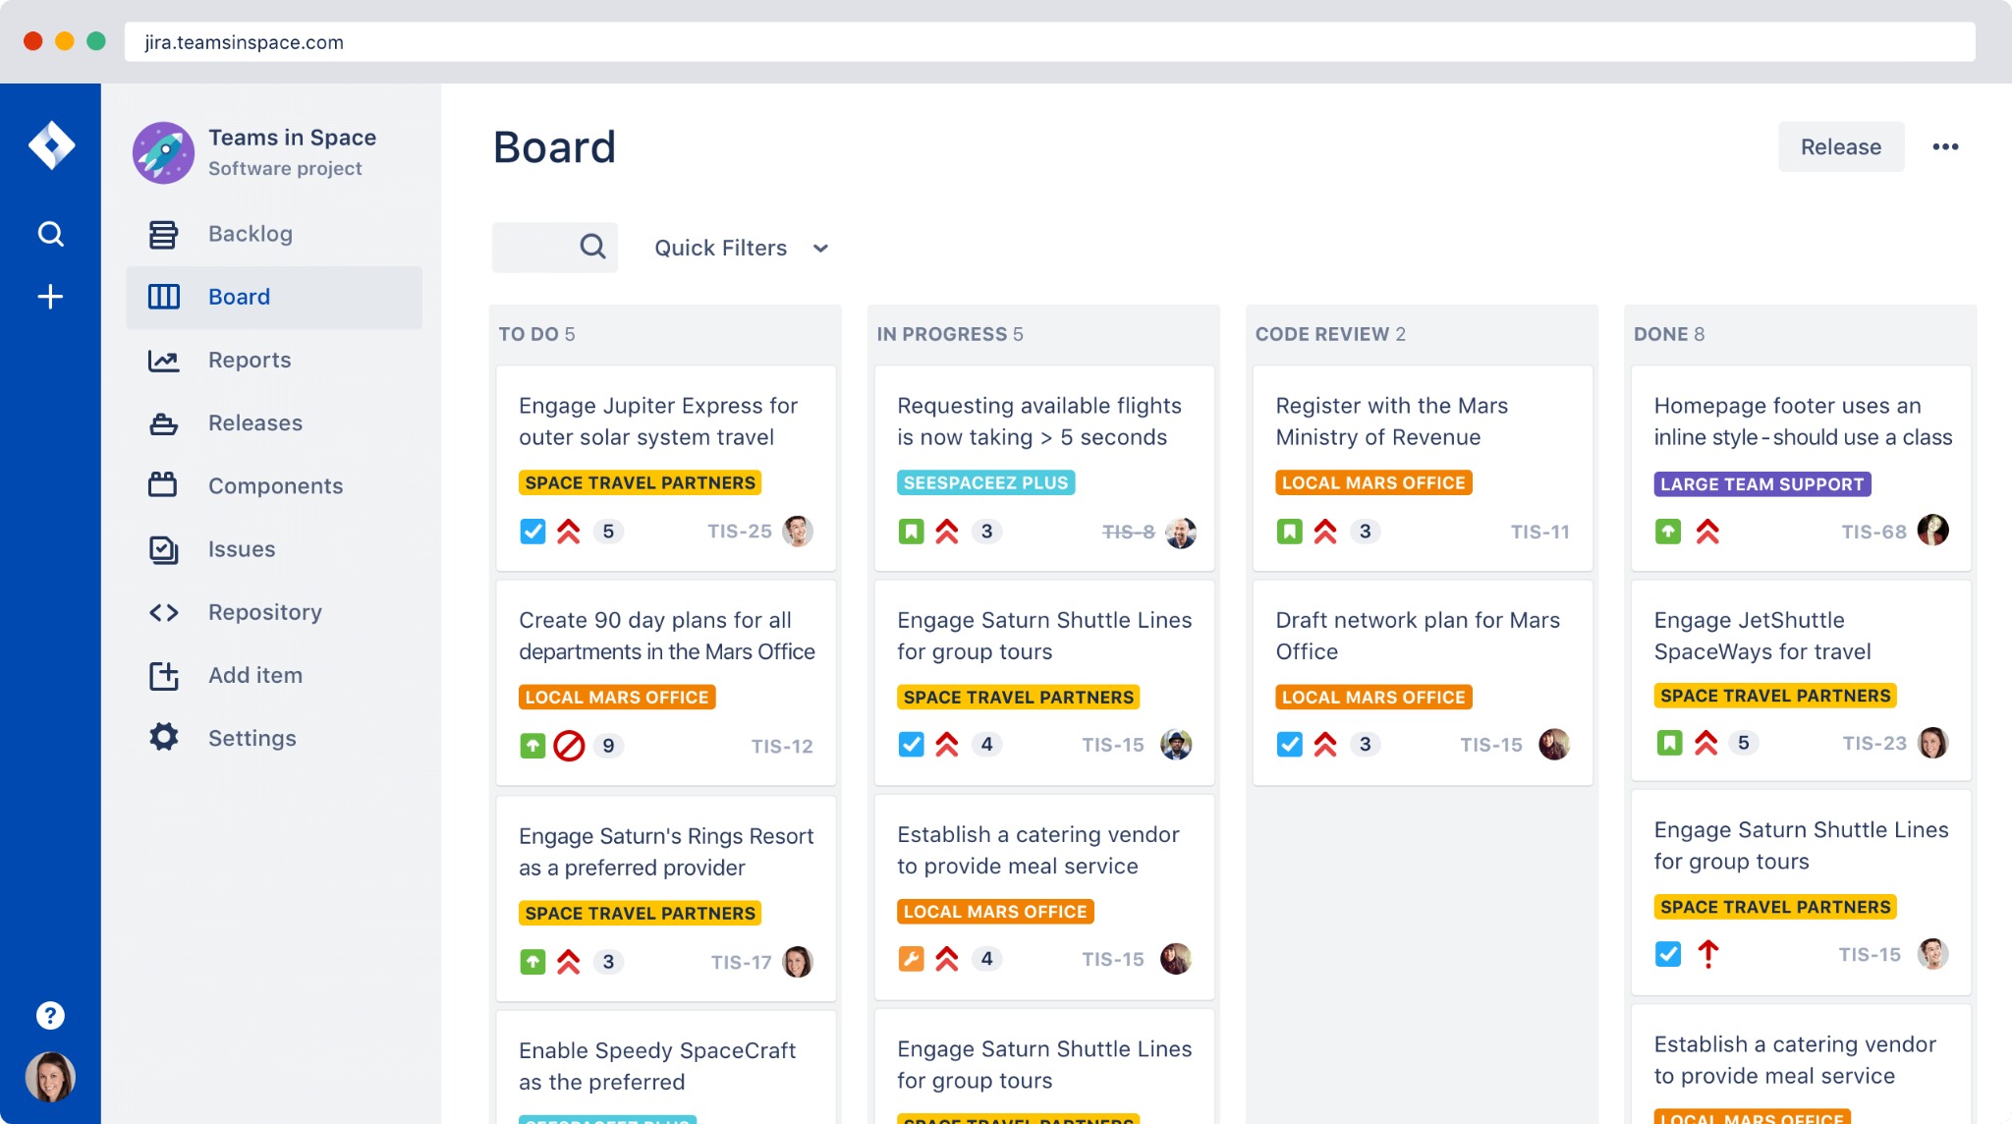

Slide 14
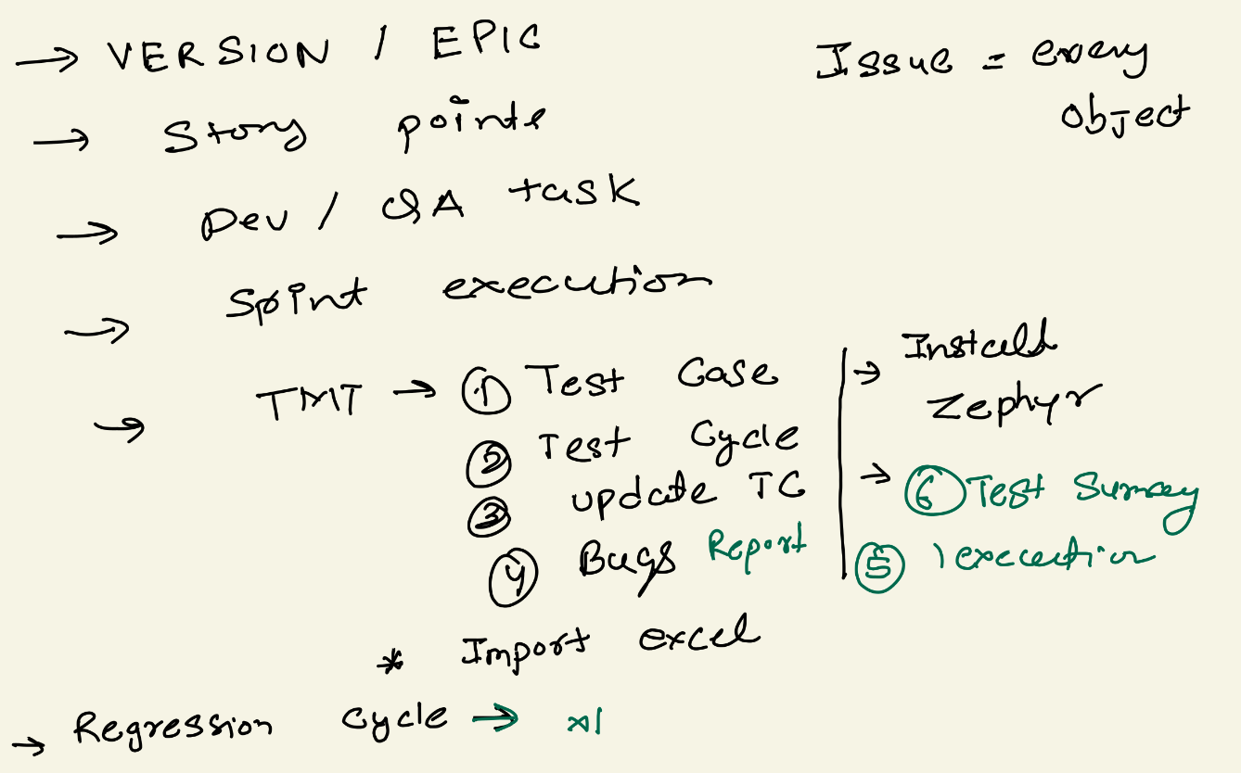

Slide 15
How to Use Jira for Test Case Management
Jira Software was not designed to serve as a Test Case Management.
It can be configured to support test case management in a couple of different ways.
You can use one of the dozens of apps available in our Atlassian Marketplace.
Zephyr
TMT https://marketplace.atlassian.com/categories/test-management

Slide 16
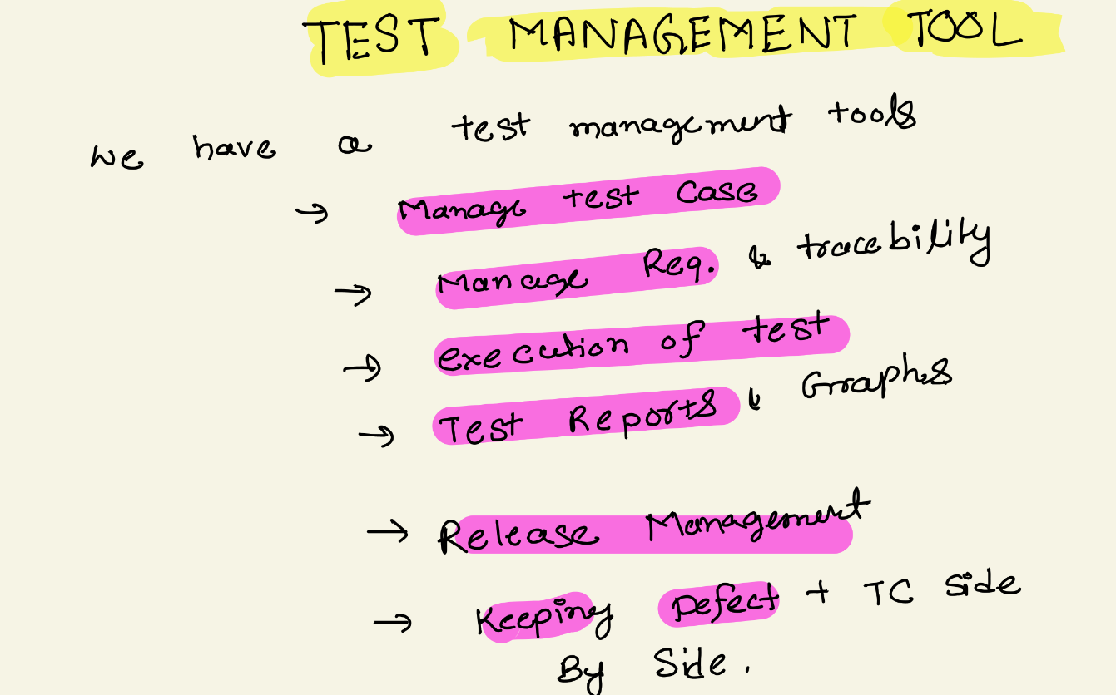

Slide 17
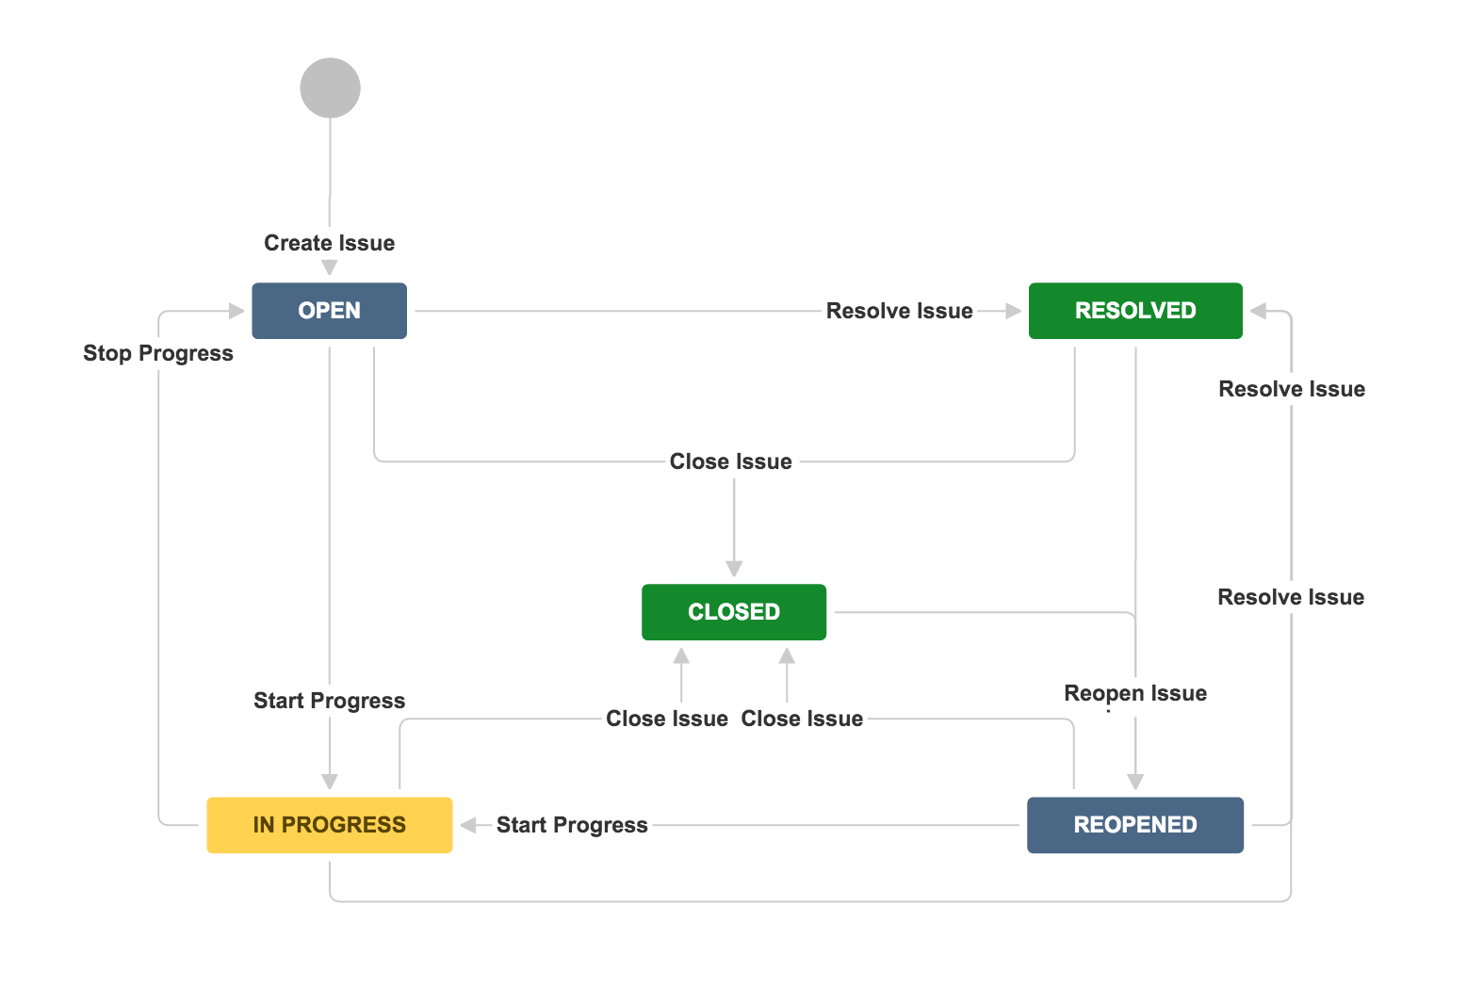
What is WorkFlow in JIRA?
The path that your issues take is called a workflow.
Jira workflow is composed of a set of statuses and transitions that your issue moves through during its lifecycle, and typically represents work processes within your organization.

Slide 18
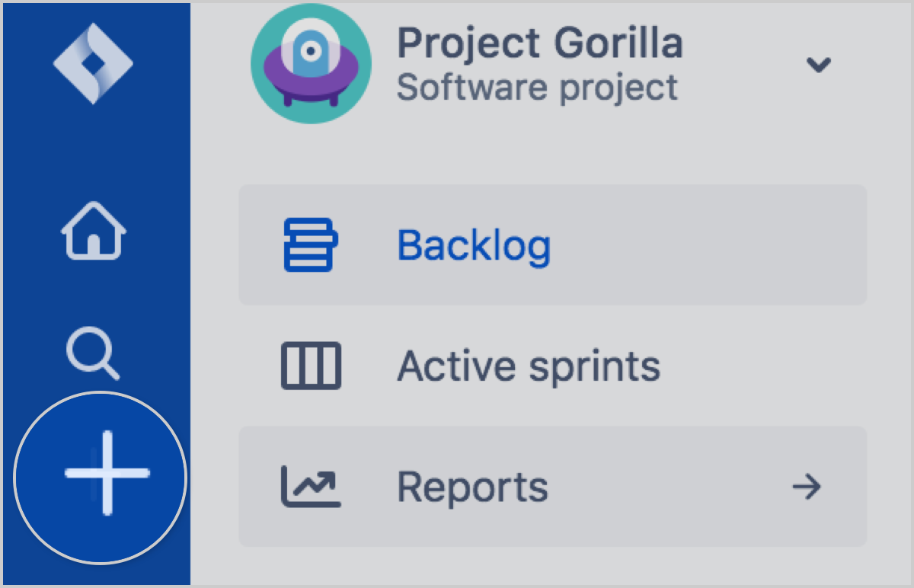
What is an Issue in JIRA?
Teams use issues to track individual pieces of work that must be completed.
an issue could represent a project task, a helpdesk ticket, a leave request form,

Slide 19
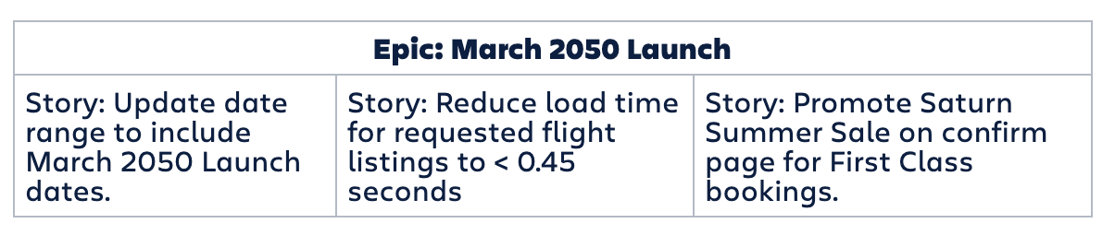
What is Epic?
Epic is a body of work that can be broken down into specific tasks (called user stories) based on the needs/requests of customers or end users.

Slide 20
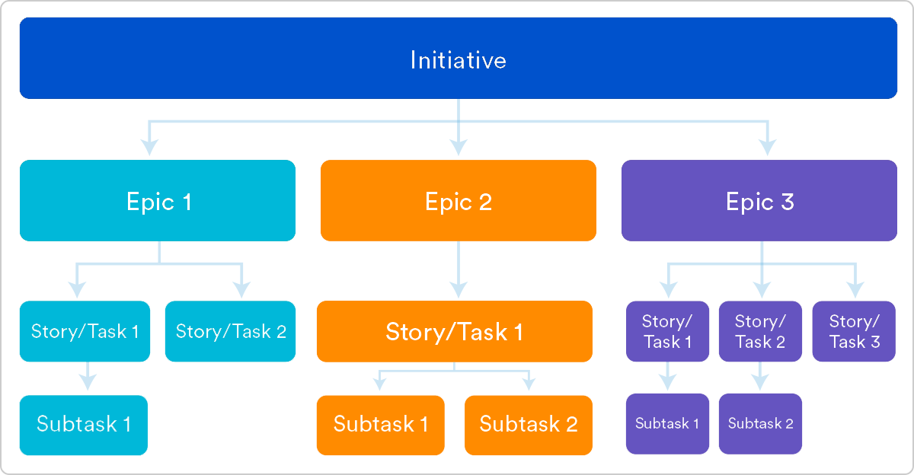
What is Epic?

Slide 21
What is Story?
A user story is an informal, general explanation of a software feature written from the perspective of the end user or customer.

Slide 22
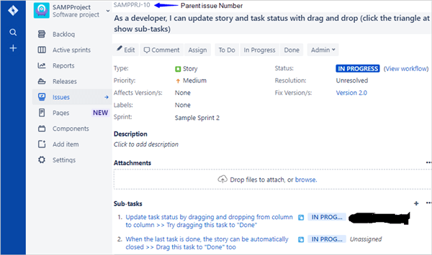
What is Task and SubTask?
Action Item, Further breakdown of Task is Subtask.

Slide 23
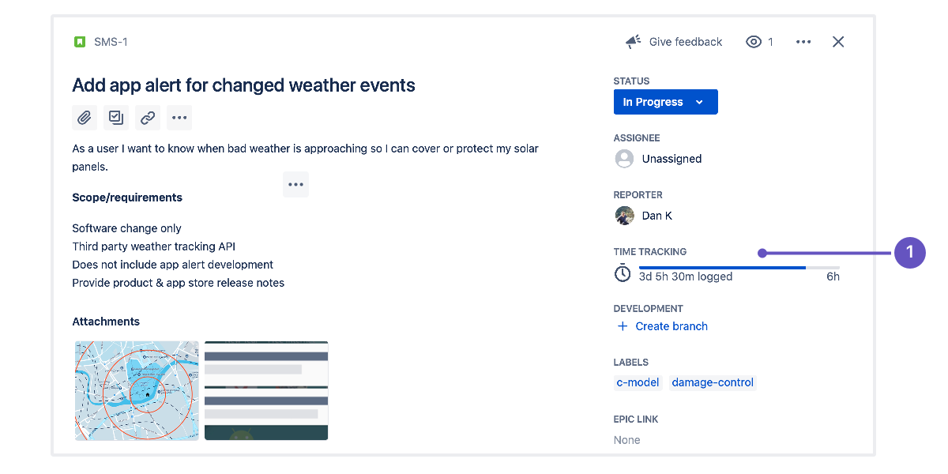
What is Time Tracking in JIRA
Time tracking lets your team record the time they spend working on issues. It's enabled by default in Jira; you won't lose any existing data if you disable or re-enable it.

Slide 24
What is Time Tracking in JIRA
Time tracking lets your team record the time they spend working on issues. It's enabled by default in Jira; you won't lose any existing data if you disable or re-enable it.

Slide 25
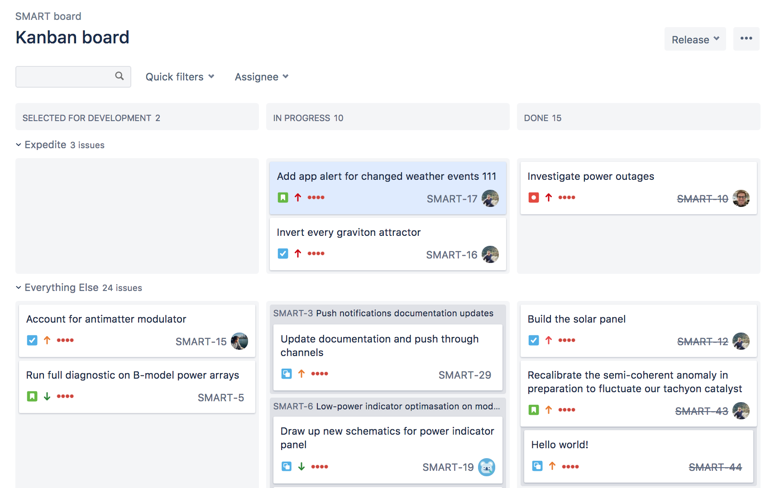
What is Kanban Board?
A kanban board is an agile project management tool designed to help visualize work, limit work-in-progress, and maximize efficiency (or flow)

Slide 26
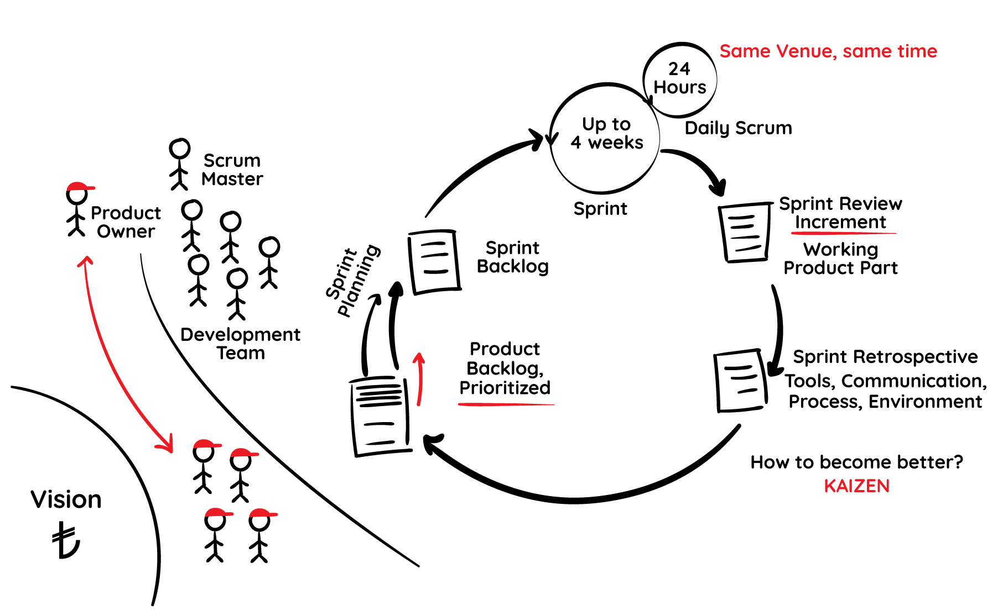
What is Scrum?
Scrum is a framework within which people can address complex adaptive problems, while productively and creatively delivering products of the highest possible.

Slide 27
Issues Types
https://confluence.atlassian.com/adminjiracloud/issue-types-844500742.html

